Slide 1

VISIT TANZANIA
2024117_JoelMwende

Slide 2
Contents
Tourism business.
Located in Tanzania.
Advertises to the native and Non-natives.

Slide 3



Software
Photoshop
Dreamweaver

Slide 4
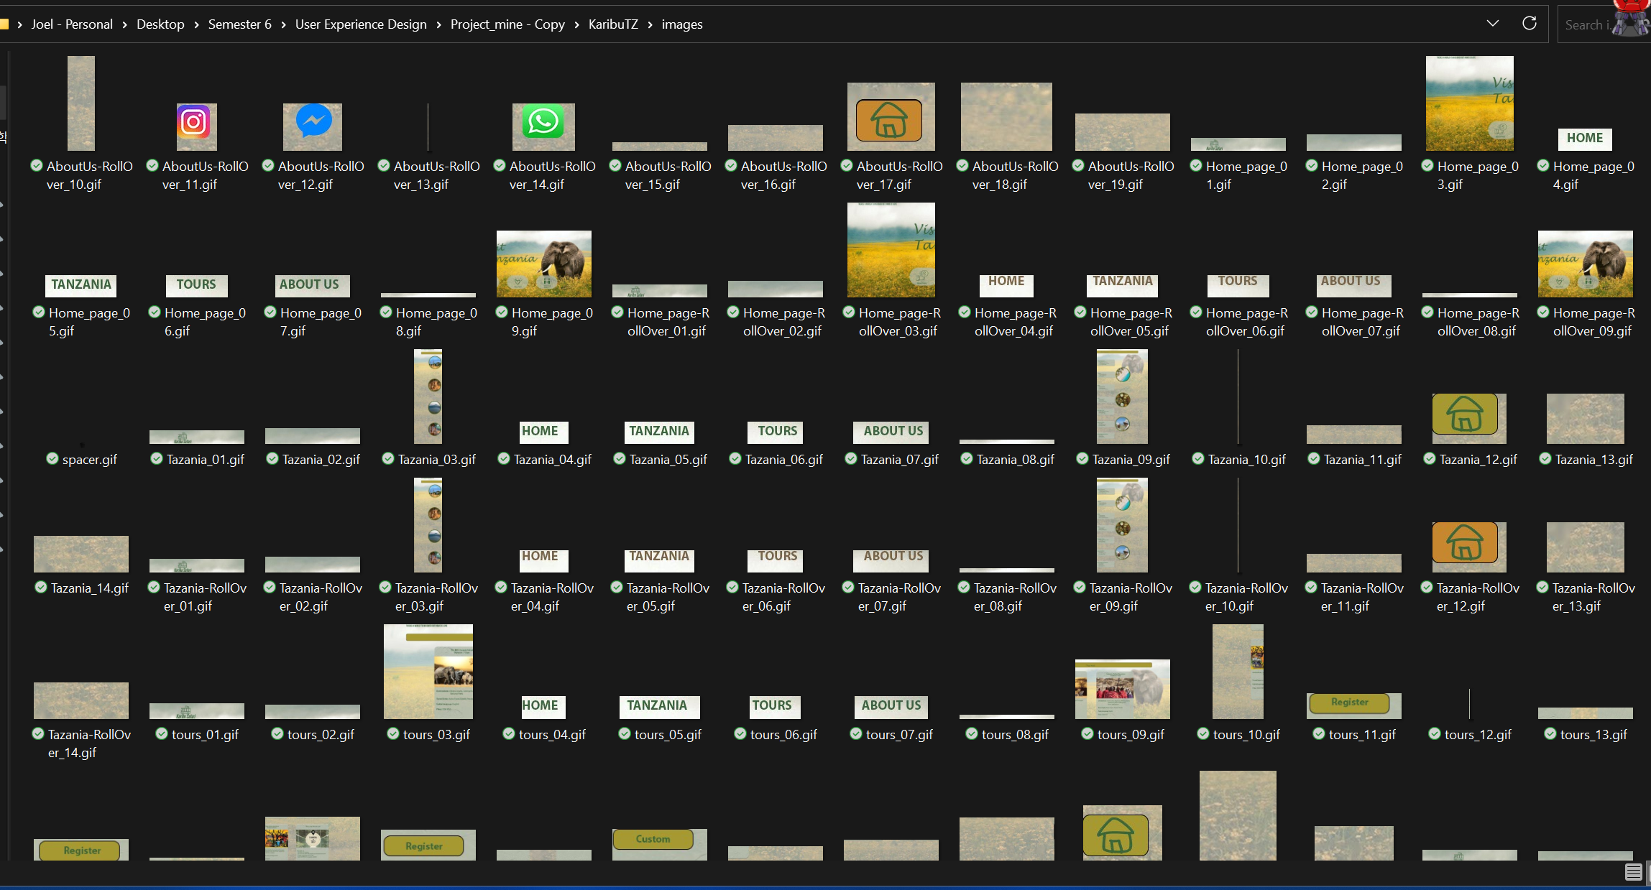
Images

Slide 5

Main Page

Slide 6
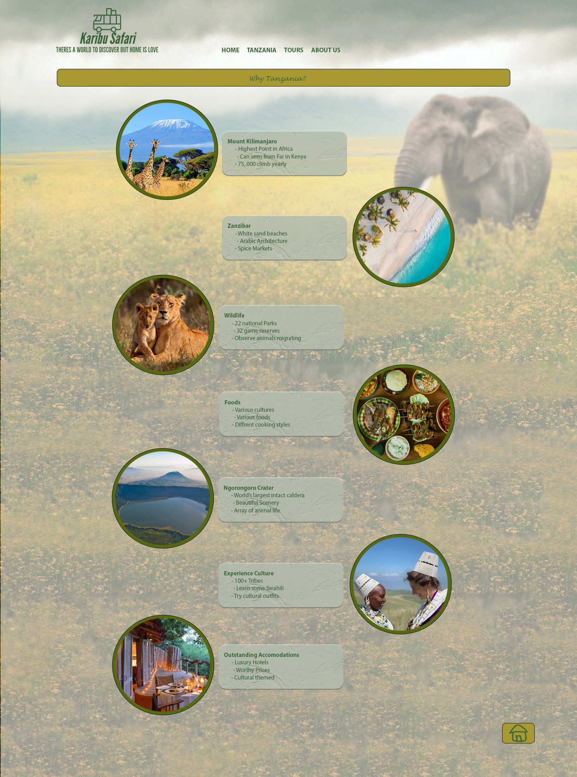
Why Tanzania

Slide 7
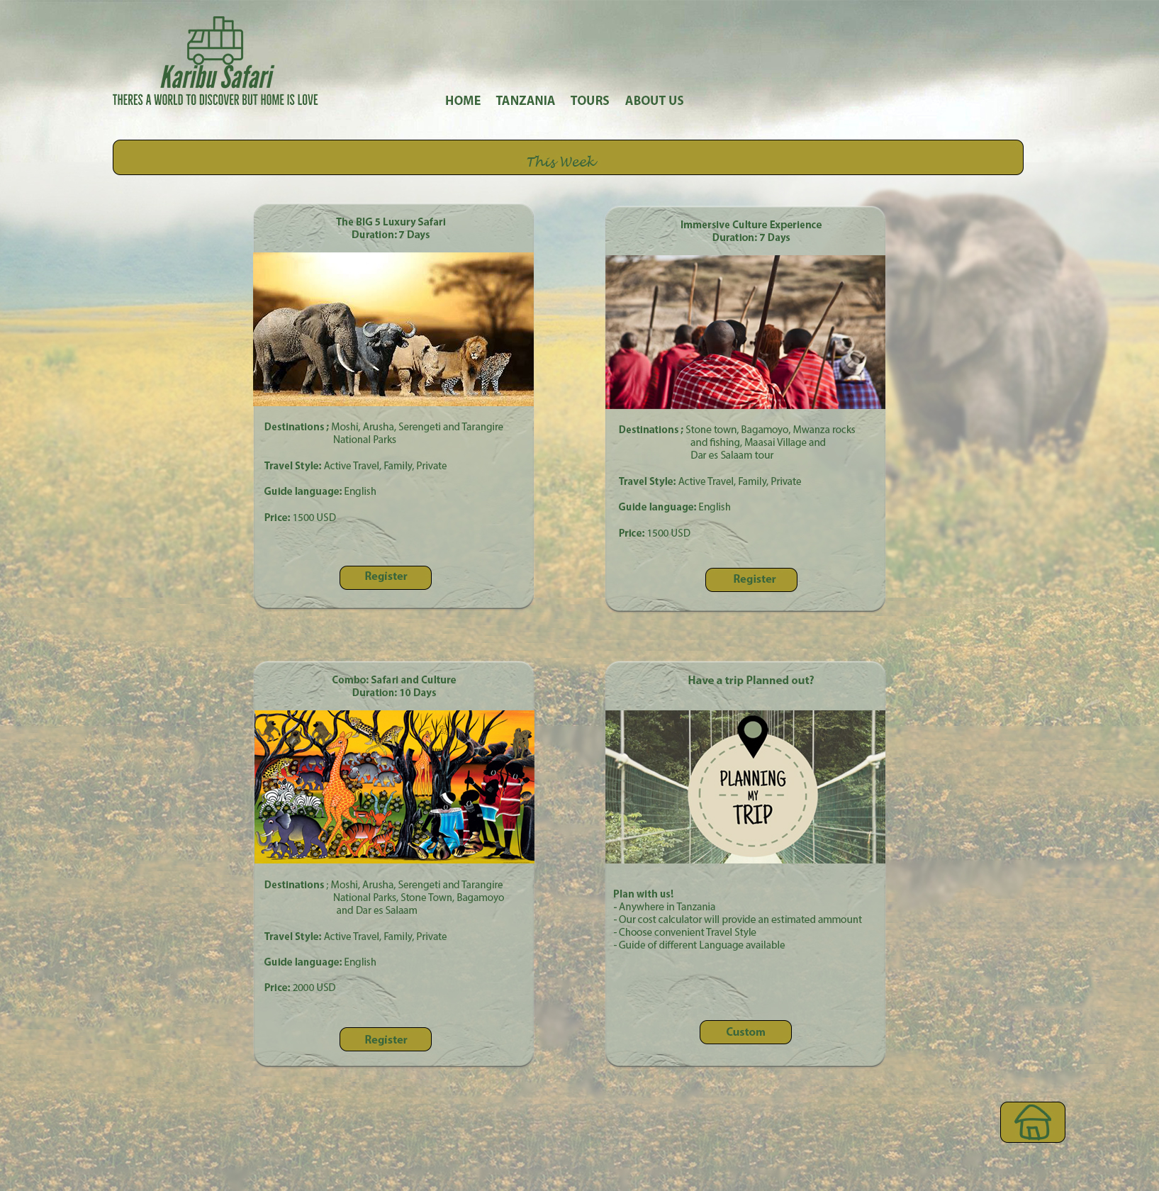
Tours

Slide 8
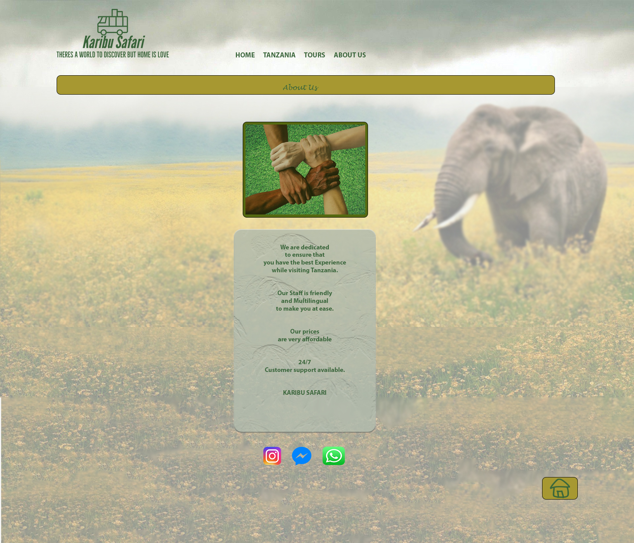
About us

Slide 9
THANK YOU ☺

